Slide 1
PREDICTION OF CHENNAI HOUSE PRICE USING MACHINE LEARNING
BY :
M.HARIHARAN

Slide 2
PROBLEM STATEMENT
THE PROBLEM IN SELLING THE HOUSE IS THAT DIFFERENT BROKERS HAVE DIFFERENT OPINION IN ESTIMATING THE PRICE .THIS MAKES BID CONFUSES ABOUT WHAT IS THE ORIGINAL PRICE OF THE HOUSE ?

Slide 3
SOLUTION
PREDICTING THE FAIR PRICE (BASED ON DATA DRIVEN)OF THE HOUSE AROUND THE CHENNAI ,BASED ON THE DATA WHICH PROVIDES THE HOUSE PRICE AROUND CHENNAI ALONG WITH MANY FEATURES SUCH AS,
LOCATION ,
ZONE
SQUARE FEET OF LAND,
BUILDTYPE,
NUMBER OF BEDROOMS,
PARKING FACILITY etc.,

Slide 4
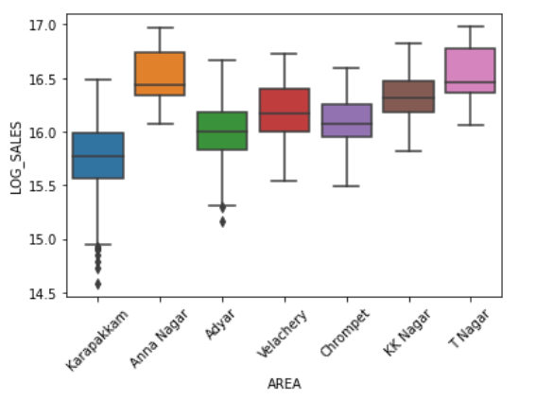
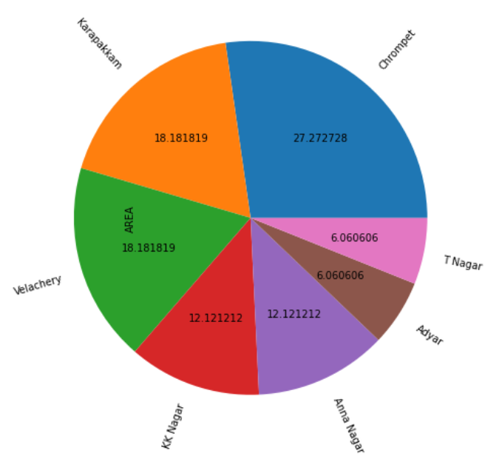
EXPLORATORY DATA ANALYSIS
PRICE OF HOUSES IN VARIOUS LOCATIONS OF CHENNAI.
ANNA NAGAR IS THE COSTLY AREA TO BUY HOUSES
PERCENTAGE OF HOUSES NEAR MAINROAD (DIST IS ZERO)
PEOPLE WHO NEED HOUSES NEAR MAINROAD CAN FIND AT CHROMPET ,KARAPAKKAM AND VELACHERY

Slide 5
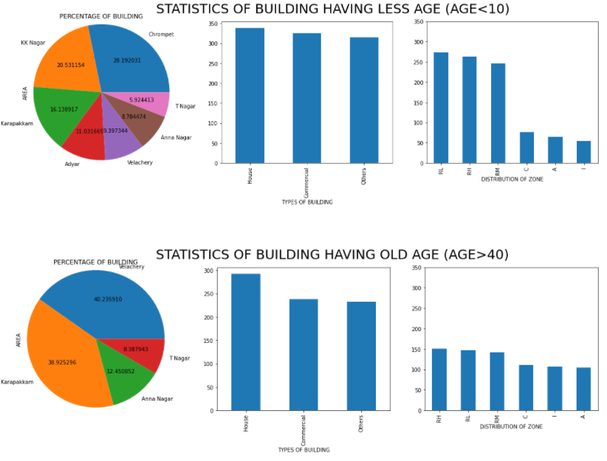
EXPLORATORY DATA ANALYSIS
INFERENCE:
RECENT TIMES, NEW BUILDINGS ARE AVAILABLE IN CHROMEPET AND KK NAGAR.
OLD BUILDINGS WERE HIGH IN VELACHERY AND KARAPAKKAM.
LESS THAN 40 YEARS A LITTLE HOUSES ARE BUILD IN AGRICULTURE OR INDUSTRIAL OR COMMERCIAL LAND
FOR BETTER CLARITY ,PLEASE CHECK MY NOTEBOOK

Slide 6
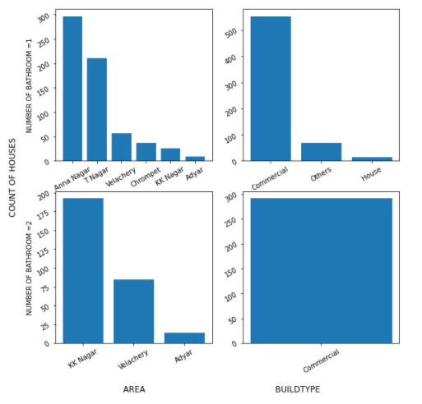
EXPLORATORY DATA ANALYSIS
HIGH PRICE HOUSES (PRICE>1,46,50719)
INFERENCE:
EVEN MORE THAN A CRORE, HOUSES ARE AVAILABLE BUT WITH SINGLE BATHROOM
ONLY COMMERICIAL BUILDING ARE AVAILABLE WITH TWO BATHROOMS AND ALSO IN KK NAGAR ,VELACHERY AND ADYAR

Slide 7
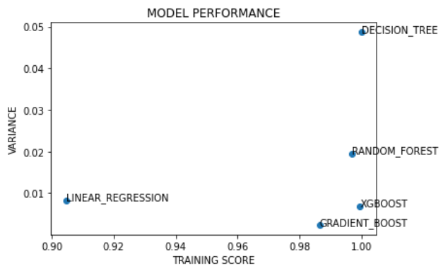
PERFORMANCE OF ML MODELS
THE PLOT DESCRIBES THE PERFORMANCE OF MODEL ON THE PARTICULAR DATA
XGBOOST MODEL PERFORMANCE WELL AND IT HAS ACCURACY OF 99.95% AND IT HAS VARIANCE <0.01 WITH UNKNOWN DATASETS
X-AXIS –LEARNING OF THE MODEL
Y-AXIS –VARIATION IN PERFORMACE ON UNKNOWN DATA

Slide 8
THANK YOU..
NOTEBOOK LINK:
https://github.com/Hariharanmadheswaran/GUVI_DATA_SCIENCE_PROJECTS/tree/main/REGRESSION

